Slide 1



Cloud Native Enterprise
Continuous Delivery & Microservice Architectures in the Enterprise with Spring and Cloud Foundry
Notes:
Resting slide on screen before you begin presenting.

Slide 2
Agenda
Why?
What?
How?
Notes:
I wanted to go over some of these emerging development models and
how tech companies have been successful in moving to these highly composable, resilient application architectures that we’re referring to as cloud native applications.
I want to show you what kind of platform tools the leading tech companies had to build.
And how these new designs are really hitting a lot of enterprises, companies that don’t depend on software directly.
We also want to showcase how these projects work together with a demo of a microservice-based Java app, built with Spring Boot and Netflix OSS projects
Before we turn it over to discussion

Slide 3
WHY
Notes:
Now I’d love to open this up for discussion.

Slide 4

Disruption to Enterprise IT is already here

Slide 5
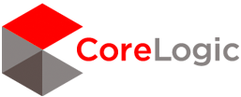


Fortune 500 Companies are Adopting Cloud Native and Microservice Models
“I said to my vendors, I don’t want five years ago. I want five years from now.
“Two people built an app and got it into the App Store in five weeks”
“The adopters we speak to today, like GE, HP, Equinix, PayPal, Capital One, Goldman Sachs, Airbnb, Medallia, Square, and Xoom say that microservices are well worth the tradeoffs.”
Notes:
We’re seeing companies like like Lockheed Martin, BMW and Philips that are incubating cloud-native design in their organizations. These companies are shipping apps to production.
Source: WSJ http://blogs.wsj.com/cio/2015/10/05/innovate-or-die-the-rise-of-microservices/
Antonio Melo, Humana, CF Summit 2015

Slide 6

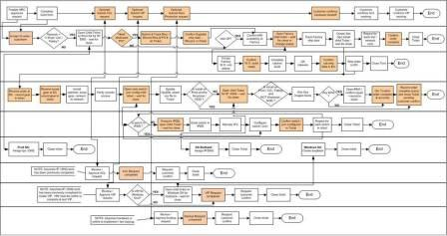
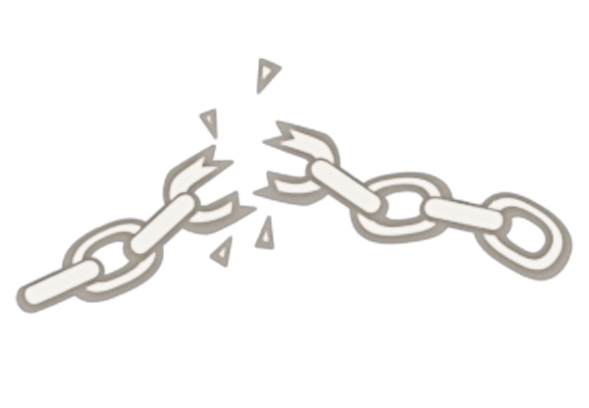
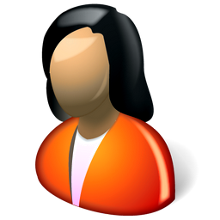
Monolithic Applications Drive Complex, Manual Deploys & Waterfall Release Cycles
Developer
Can you deliver full CI/CD for every major app in your portfolio today, or are you doing 75+ step manual deployments?
Operator
Notes:
We’re working with customers like Comcast and Lockheed Martin who have been struggling to ship software faster. Both in terms of new projects and implementing these modern, DevOps-friendly environments that can handle real continuous delivery.
If you’re doing big project with ‘agile waterfall’ where you use agile development with weekly sprints but have a huge manual process to actually ship every 3-9months.
Disconnect between dev and ops. Throw the code over the wall
… and do it all over again from Dev → Test → Prod on any infrastructure

Slide 7
The Promise of Cloud Native
Deploy new features *daily* to production
Faster Feedback (experiment)
Outcome not activity focus (optimize)
Loose Coupling (upgrades and fixes)
Self-service, automated middleware
Free/Cheap horizontal scaling
No Downtime Upgrades
Availability and resiliency

Slide 8
WHAT
Notes:
Now I’d love to open this up for discussion.

Slide 9

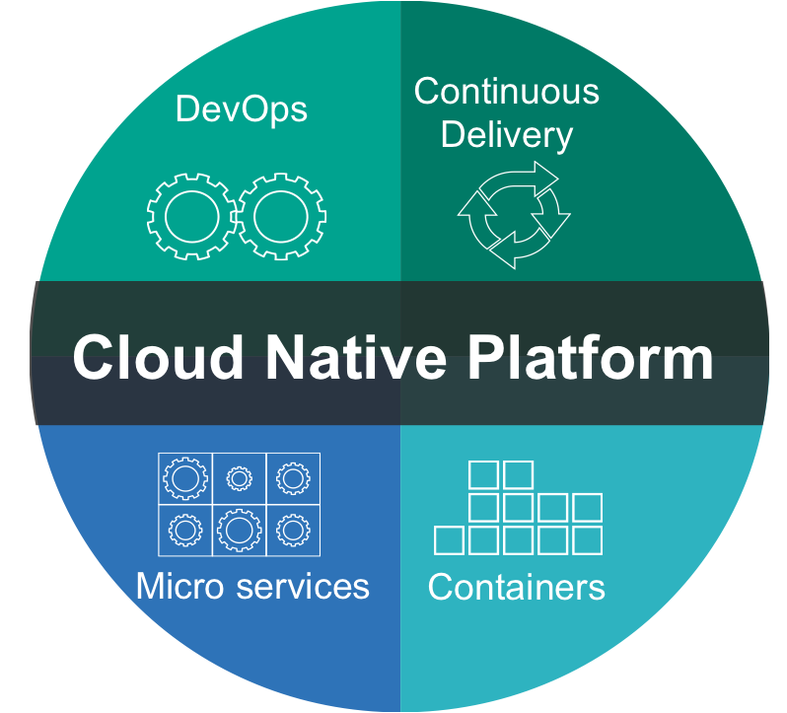
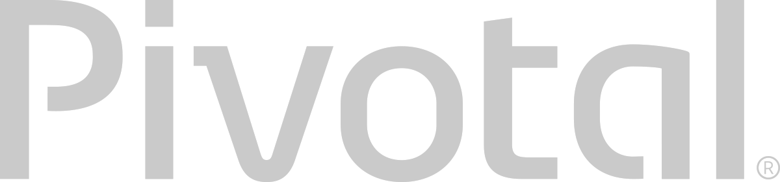
What is Cloud Native?
A term that recognizes that getting software to work in the cloud requires a broad set of components that work together.
It requires an architecture that departs from traditional enterprise application design, such as ‘Microservices’
It requires a Cloud Native platform
Notes:
http://www.informationweek.com/cloud/platform-as-a-service/cloud-native-what-it-means-why-it-matters/d/d-id/1321539

Slide 10
Characteristics of Cloud Native Architectures
Twelve Factor Apps (http://12factor.net/)
Continuously Delivered
Microservices
DevOps
Self-Service agile infrastructure
API-based collaboration
Anti-fragility

Slide 11
Characteristics of Cloud Native Architectures
Twelve Factor Apps (http://12factor.net/)
Continuously Delivered
Microservices
DevOps
Self-Service agile infrastructure
API-based collaboration
Anti-fragility

Slide 12

12-Factor Applications
Codebase
Dependencies
Configuration
Backing Services
Build, release, run
Processes
Port binding
Concurrency
Disposability
Dev/prod parity
Logs
Admin processes
APPS
contract
Cloud Platform
Architectural and development practices – http://12factor.net
Notes:
References:
http://12factor.net/
Architectural and development practices, that ensure an optimal experience on a cloud platform.

Slide 13
Characteristics of Cloud Native Architectures
Twelve Factor Apps (http://12factor.net/)
Microservices
DevOps
Self-Service agile infrastructure
API-based collaboration
Anti-fragility

Slide 14
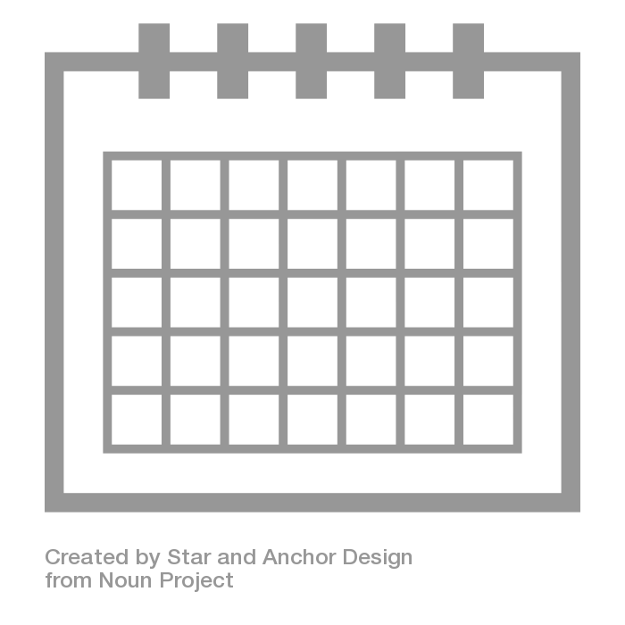
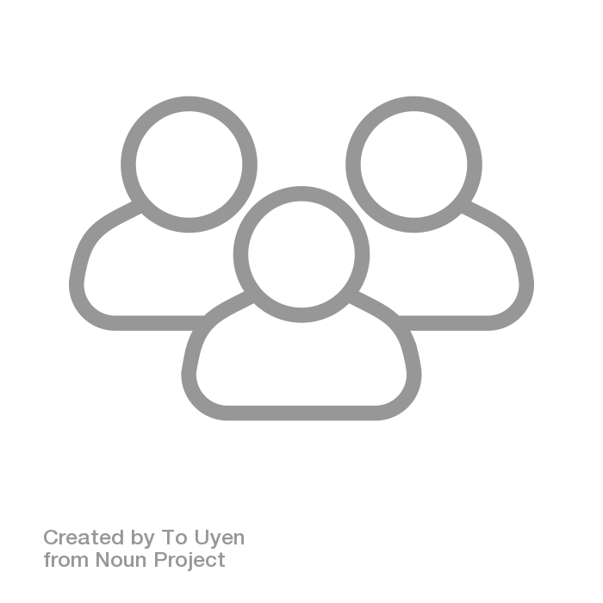
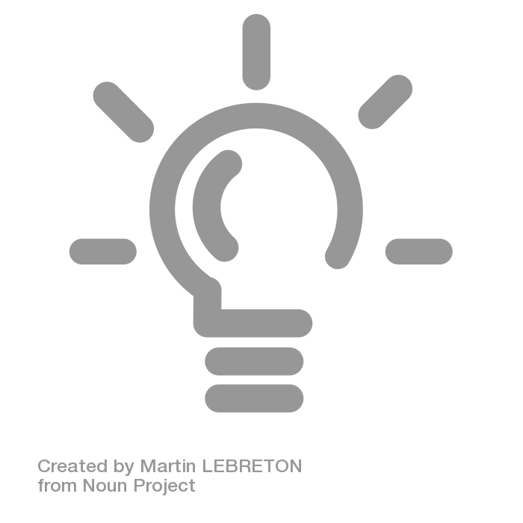

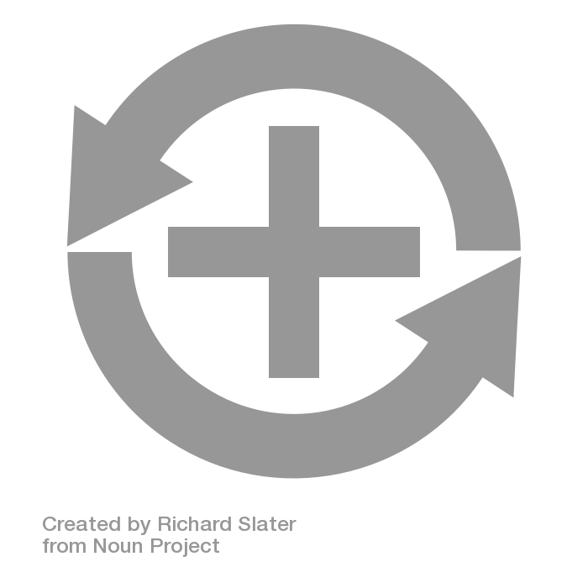
Apps
6+ Months
Plan
Dev
Test
Deploy
Operate
Notes:
Light Bulb by Martin LEBRETON from the Noun Project
multiple users by To Uyen from the Noun Project
dollar sign by icon 54 from the Noun Project
Positive Feedback Loop by Richard Slater from the Noun Project
Calendar by Star and Anchor Design from the Noun Project

Slide 15
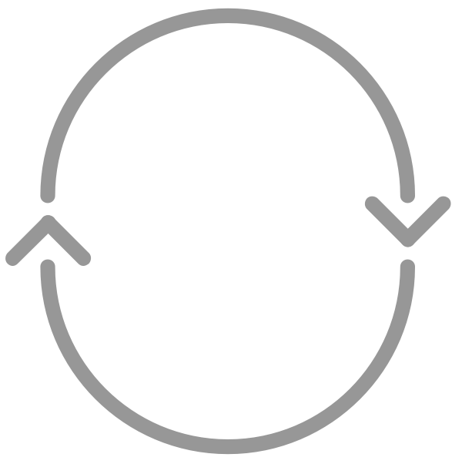
Apps
Agile!
6+ Months
CI
Plan
Dev
Test
Deploy
Operate
Notes:
Light Bulb by Martin LEBRETON from the Noun Project
multiple users by To Uyen from the Noun Project
dollar sign by icon 54 from the Noun Project
Positive Feedback Loop by Richard Slater from the Noun Project
Calendar by Star and Anchor Design from the Noun Project
cycle by Chris Jones from the Noun Project

Slide 16
Apps
Water -
Scrum
Agile!
- Fall
CI
Plan
Dev
Test
Deploy
Operate
CI
-Code
-CI
-Build
-Unit Tests
-Artifact
SIT
FT
UAT
Perf
Prod
-H/W & VM
-OS
-Runtime
-Middleware
-Network
-Services
-Config
-Code
-Tests
-H/W & VM
-OS
-Runtime
-Middleware
-Network
-Services
-Config
-Code
-Tests
-H/W & VM
-OS
-Runtime
-Middleware
-Network
-Services
-Config
-Code
-Tests
-H/W & VM
-OS
-Runtime
-Middleware
-Network
-Services
-Config
-Code
-Tests
-H/W & VM
-OS
-Runtime
-Middleware
-Network
-Services
-Config
-Code
-Tests
Inconsistent, Corrupt & Dirty
Notes:
Light Bulb by Martin LEBRETON from the Noun Project
multiple users by To Uyen from the Noun Project
dollar sign by icon 54 from the Noun Project
Positive Feedback Loop by Richard Slater from the Noun Project
Calendar by Star and Anchor Design from the Noun Project
cycle by Chris Jones from the Noun Project

Slide 17
Apps
Agile
DevOps
CI
CD - Automate
Plan
Dev
Test
Deploy
Operate
CI
-Code
-CI
-Build
-Unit Tests
-Artifact
SIT
FT
UAT
Perf
Prod
-H/W & VM
-OS
-Runtime
-Middleware
-Network
-Services
-Config
-Code
-Tests
-H/W & VM
-OS
-Runtime
-Middleware
-Network
-Services
-Config
-Code
-Tests
-H/W & VM
-OS
-Runtime
-Middleware
-Network
-Services
-Config
-Code
-Tests
-H/W & VM
-OS
-Runtime
-Middleware
-Network
-Services
-Config
-Code
-Tests
-H/W & VM
-OS
-Runtime
-Middleware
-Network
-Services
-Config
-Code
-Tests
Automated Platform
Notes:
Light Bulb by Martin LEBRETON from the Noun Project
multiple users by To Uyen from the Noun Project
dollar sign by icon 54 from the Noun Project
Positive Feedback Loop by Richard Slater from the Noun Project
Calendar by Star and Anchor Design from the Noun Project
cycle by Chris Jones from the Noun Project

Slide 18
Characteristics of Cloud Native Architectures
Twelve Factor Apps (http://12factor.net/)
Continuously Delivered
Microservices
DevOps
Self-Service agile infrastructure
API-based collaboration
Anti-fragility

Slide 19
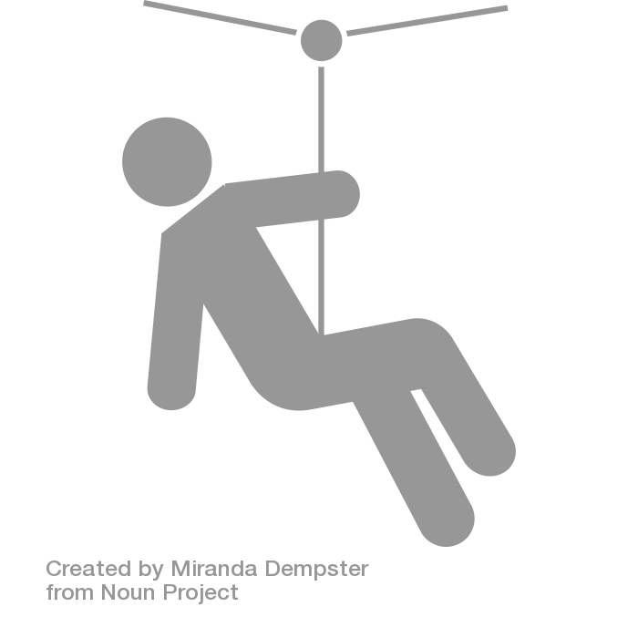
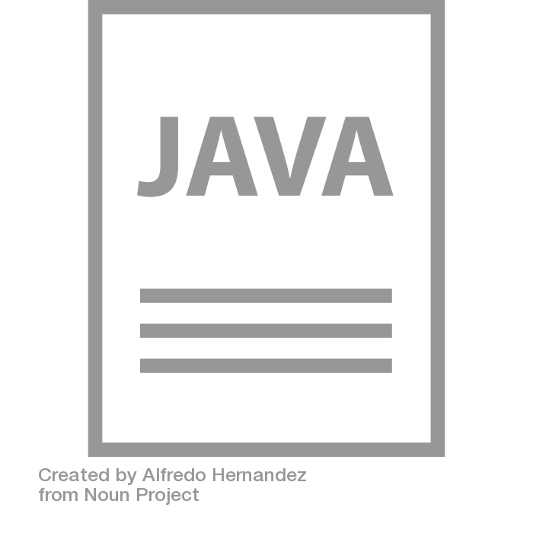
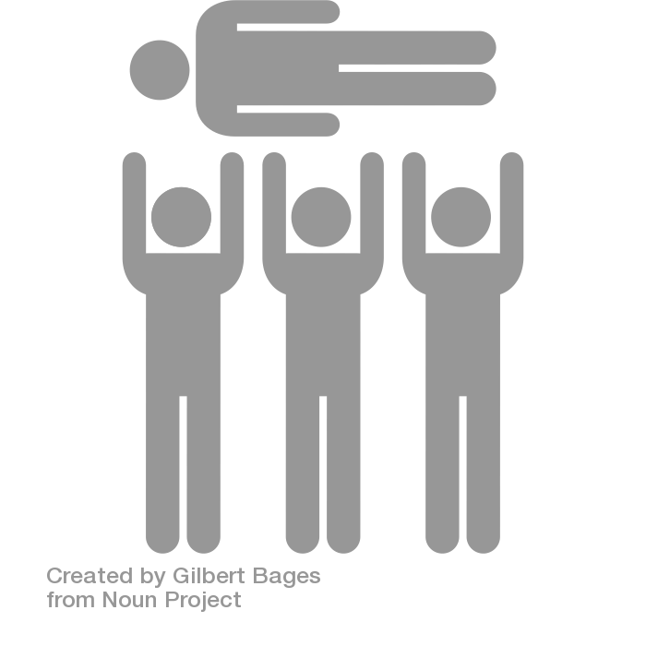
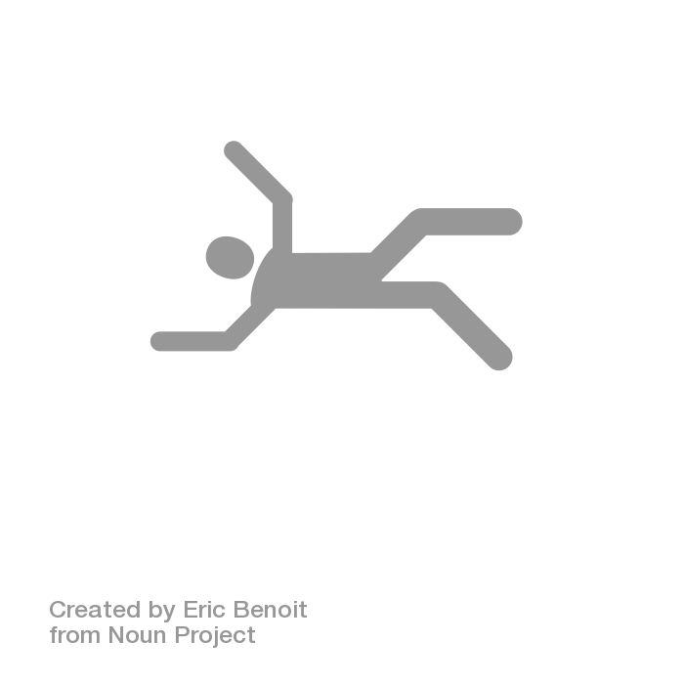
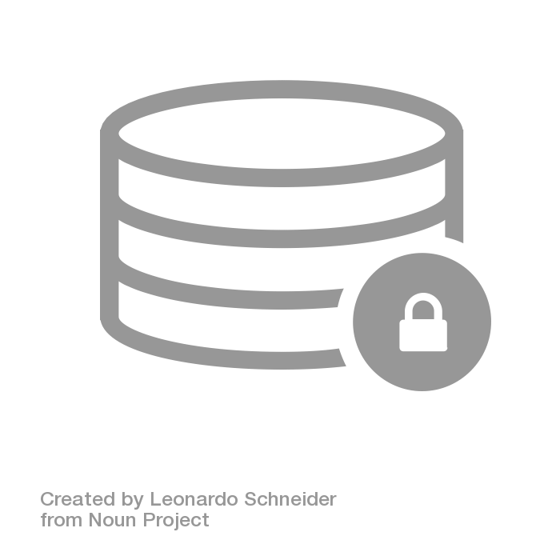

The Monolithic Application
HTML
Java
Script
MVC
X
Service
Service
6+ Months
Data Access
Notes:
Big commitment
falling by Eric Benoit from the Noun Project
Zipline by Miranda Dempster from the Noun Project
Crowd Surfing by Gilbert Bages from the Noun Project
JAVA File by Alfredo Hernandez from the Noun Project
Secure Database by Leonardo Schneider from the Noun Project

Slide 20
What are Microservices?
If every service has to be updated in concert, it’s not loosely coupled!
Loosely coupled service oriented architecture with bounded contexts
If you have to know about surrounding services you don’t have a bounded context.
Notes:
I presume you’re all familiar with microservices and cloud-native, but quickly, here’s an introduction. They’re loosely coupled, service oriented architecture with bounded contexts.
Because each service can be updated independently, your teams can work in parallel. Because each service is isolated, it’s much easier to automate your testing.

Slide 21
Trend towards new lightweight architectures
Microservices addressing speed to market and cloud scale
MONOLITHIC/LAYERED
MICROSERVICES
Notes:
Enterprise companies in finance and telco industries are embracing microservice and cloud-native models.
There are new architectures emerging atop these lightweight app servers to address the scale, speed and safety: new ways of tackling cloud scale and speed to market. Microservices has emerged from the internet giants as such an alternative: a change in culture, organization structure and technology that allows teams to work more independently, and increase velocity. It’s a key part of cloud-native applications, which we’ll talk about shortly.
Microservices are both a cultural and organizational change as a change in how we design and implement systems.

Slide 22
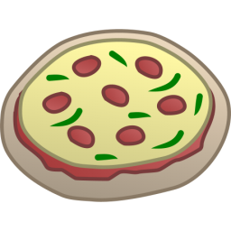
One-Size-Fits-All Methodologies have become an Anti-pattern to the Business
HTML
Java
Script
MVC
Service
Service
Data Access
Monolithic Application
> 2 Pizzas Per Project = Too Many Pizzas

Slide 23



Agile, Disruptive Companies Use Non-traditional, Modular Approaches to Software Systems
Microservice based architecture
Relational
DB
Key/Value
Store
AQMP
…..........
Shared
DB
DB Service
Caching Service
Messaging Service
Two Pizzas Per Microservice = Manageable!
Notes:
To build a Microservices architecture at scale requires a platform

Slide 24

Microservices are NOT
Monolithic Application
Service
Service
HTML
JavaScript
MVC
Enterprise Service Bus
Service
Service
OR
Data Access
Service
Service
Tightly Coupled
Centralized

Slide 25
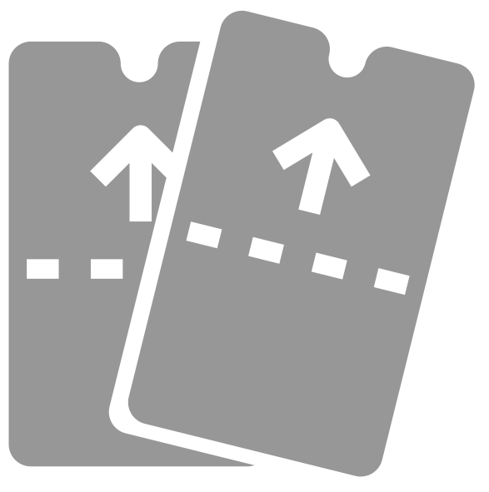
SOA Architecture
Business Change
HTML
JavaScript
MVC
Service
Service
Enterprise Service Bus
Data Access
Notes:
Zipline by Miranda Dempster from the Noun Project
tickets by Kerry Webster from the Noun Project

Slide 26




Microservice Architecture
Business Change
HTTP
HTTP
HTTP
HTTP
HTTP
HTTP
AMQP
AMQP
…
Relational
DB
Key/Value
Store
Graph
DB
Notes:
REST and message-driven services
Polyglot persistence, services encapsulate data store semantics
Diversity of clients acknowledged
API Gateway for service aggregation, reduce chattiness, protocol translation, reduce latency/round-trips, deal with mobile device fragmentation, build use case/device specific API’s

Slide 27
Characteristics of Cloud Native Architectures
Twelve Factor Apps (http://12factor.net/)
Continuously Delivered
Microservices
DevOps
Self-Service agile infrastructure
API-based collaboration
Anti-fragility

Slide 28
Apps
Agile
DevOps
CI
CD - Automate
Plan
Dev
Test
Deploy
Operate
CI
-Code
-CI
-Build
-Unit Tests
-Artifact
SIT
FT
UAT
Perf
Prod
-H/W & VM
-OS
-Runtime
-Middleware
-Network
-Services
-Config
-Code
-Tests
-H/W & VM
-OS
-Runtime
-Middleware
-Network
-Services
-Config
-Code
-Tests
-H/W & VM
-OS
-Runtime
-Middleware
-Network
-Services
-Config
-Code
-Tests
-H/W & VM
-OS
-Runtime
-Middleware
-Network
-Services
-Config
-Code
-Tests
-H/W & VM
-OS
-Runtime
-Middleware
-Network
-Services
-Config
-Code
-Tests
Automated Platform
Notes:
Light Bulb by Martin LEBRETON from the Noun Project
multiple users by To Uyen from the Noun Project
dollar sign by icon 54 from the Noun Project
Positive Feedback Loop by Richard Slater from the Noun Project
Calendar by Star and Anchor Design from the Noun Project
cycle by Chris Jones from the Noun Project

Slide 29
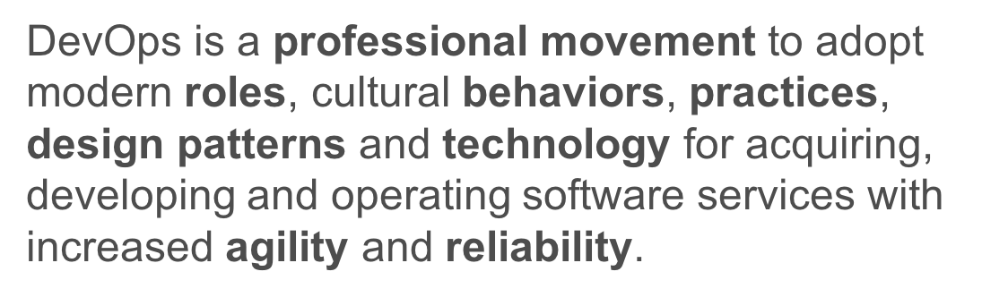

Slide 30
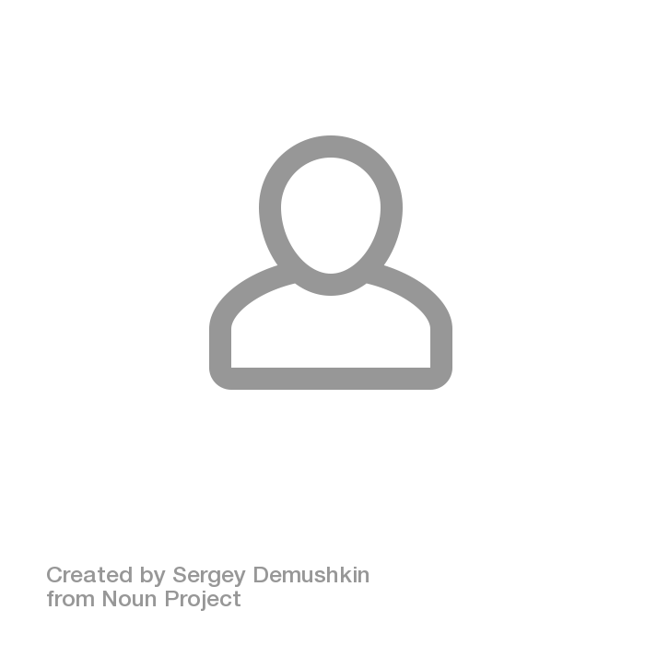
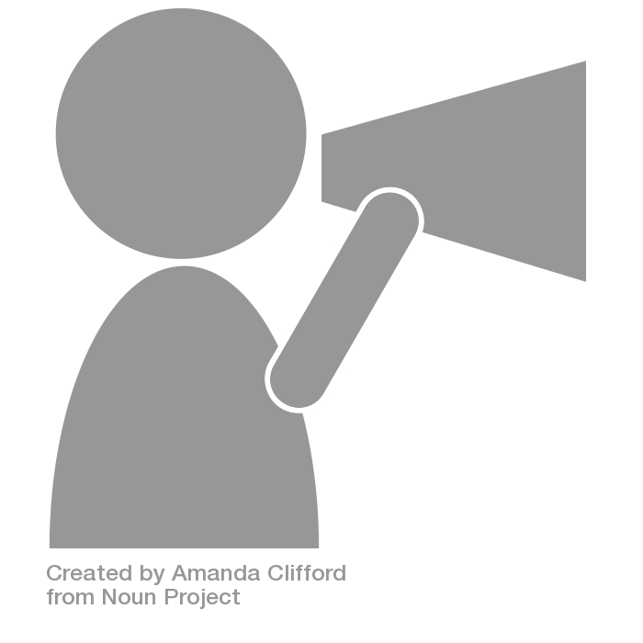
Agile Org Structures
BO/Product
BO/Product
BO/Product
Arch
UI/Mobile
Services
DBA
Deploy
Infrastructure
OPS
Notes:
User by Sergey Demushkin from the Noun Project
Announcement by Amanda Clifford from the Noun Project

Slide 31
Conway’s Law
“Any organization that designs a system (defined broadly) will produce a design whose structure is a copy of the organization's communication structure.”
- Melvin Conway, 1967
http://www.melconway.com/Home/Committees_Paper.html
Notes:
Inverse Conway Maneuver coined by Thoughtworks - http://jonnyleroy.com/2011/02/03/dealing-with-creaky-legacy-platforms/
Goal is to create self contained, business aligned teams with the smallest feedback loop.
Business capability teams interact with platform operations team via APIs and not meetings. This creates a friction free experience for the business capability team who now have the tools to

Slide 32
Inverse Conway Maneuver Enable Continuous Delivery
Product Mgr.
Dev
UX
QA
DBA
Self
Service
APIS
Sys Admin
Network Admin
Storage Admin
Business Capabilities Team Using Microservices
Platform Operations Team
http://jonnyleroy.com/2011/02/03/dealing-with-creaky-legacy-platforms/
http://www.slideshare.net/adriancockcroft/microservices-the-good-bad-and-the-ugly
Notes:
References:
Inverse Conway Maneuver coined by Thoughtworks - http://jonnyleroy.com/2011/02/03/dealing-with-creaky-legacy-platforms/
http://www.slideshare.net/adriancockcroft/microservices-the-good-bad-and-the-ugly
Notes:
Goal is to create self contained, business aligned teams with the smallest feedback loop.
Business capability teams interact with platform operations team via APIs and not meetings. This creates a friction free experience for the business capability team who now have the tools to

Slide 33


Enabling Continuous Delivery
Production Release
ORDERS
Production Release
Production Release
SHIPPING
Production Release

Slide 34
Characteristics of Cloud Native Architectures
Continuously Delivered
DevOps
Twelve Factor Apps (http://12factor.net/)
Microservices
Self-Service agile infrastructure
API-based collaboration
Anti-fragility

Slide 35
It Takes a Platform
An end-to-end platform that makes implementing distributed application best practices, a turn-key and first practice
Notes:
Inverse Conway Maneuver coined by Thoughtworks - http://jonnyleroy.com/2011/02/03/dealing-with-creaky-legacy-platforms/
Goal is to create self contained, business aligned teams with the smallest feedback loop.
Business capability teams interact with platform operations team via APIs and not meetings. This creates a friction free experience for the business capability team who now have the tools to

Slide 36
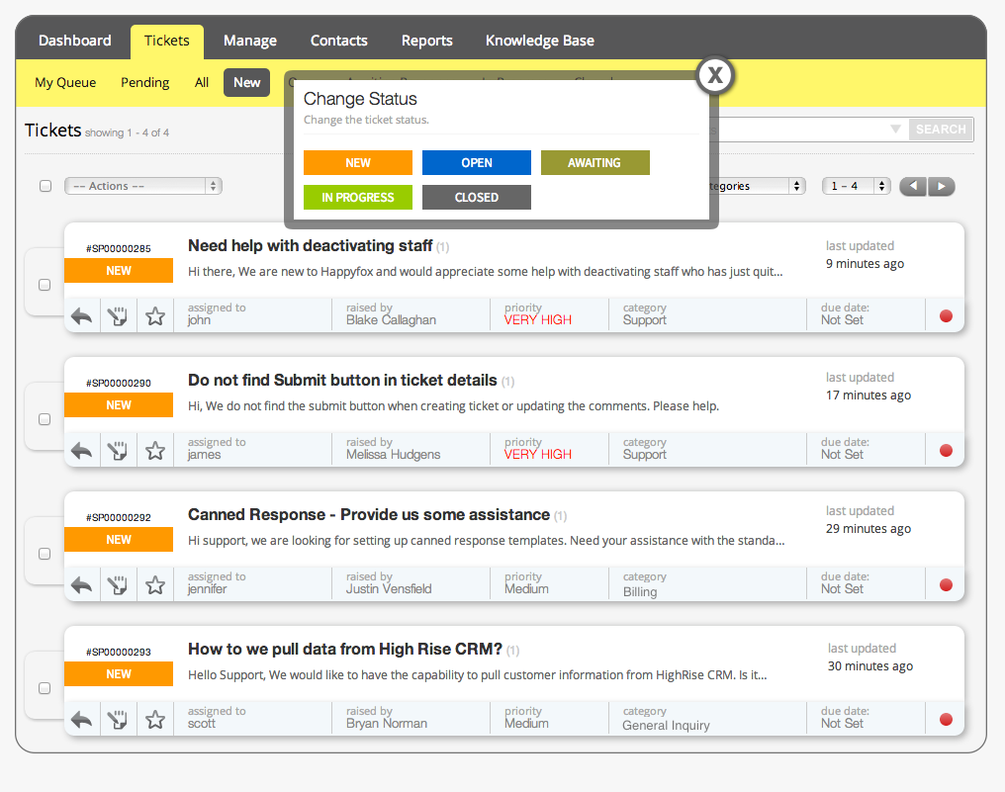

Slide 37
Characteristics of Cloud Native Architectures
Continuously Delivered
DevOps
Twelve Factor Apps (http://12factor.net/)
Microservices
Self-Service agile infrastructure
API-based collaboration
Anti-fragility

Slide 38
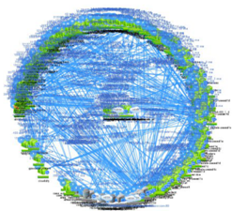
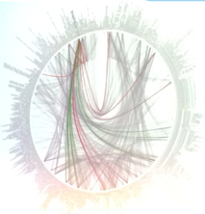
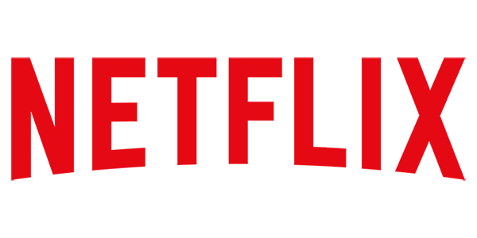
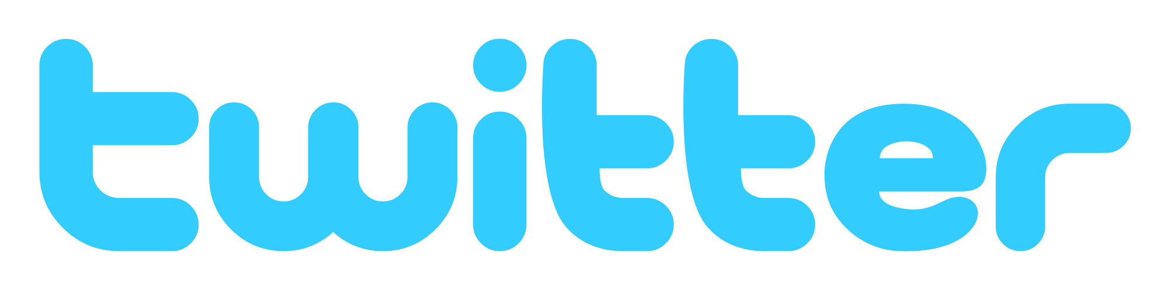
However… Microservices are Hard
Notes:
Distributed systems are HARD
Configuration Management
Service Registration & Discovery
Routing & Load Balancing
Fault Tolerance (Circuit Breakers)
Monitoring
Concurrent API Aggregation & Transformation
----- Meeting Notes (2/24/16 13:58) -----
Dependency Map

Slide 39
Challenges of Distributed Systems
Configuration Management
Service Registration & Discovery
Routing & Load Balancing
Fault Tolerance (Circuit Breakers)
Monitoring and Tracing
Concurrent API Aggregation & Transformation
Notes:
Everybody faces these, SCS takes PCF to the next level

Slide 40
HOW
Notes:
Now I’d love to open this up for discussion.

Slide 41




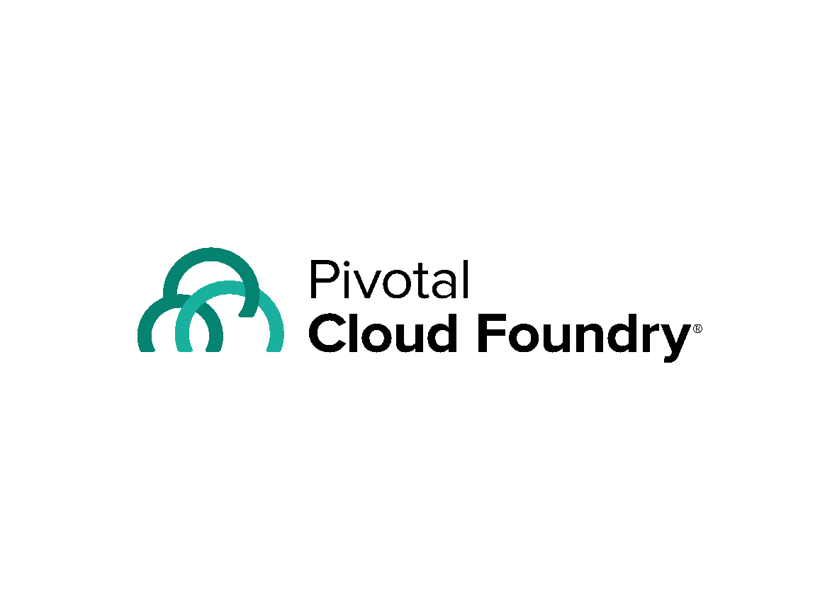
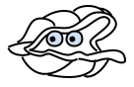





Cloud Native Platform and Contracts
Culture
Framework
Tools
Application Framework
Spring Cloud
Spring Boot
Dev
Contract: 12 Factor App
Runtime Platform
Pivotal
Cloud Foundry
Dev
IT Ops
Contract: BOSH Release
Infrastructure Automation
BOSH
IT Ops
Contract: Cloud Provider Interface
Infrastructure
Azure
IT Ops
Notes:
And all of this is enforced through strict API contracts that allow you to go FAST and be safe.

Slide 42
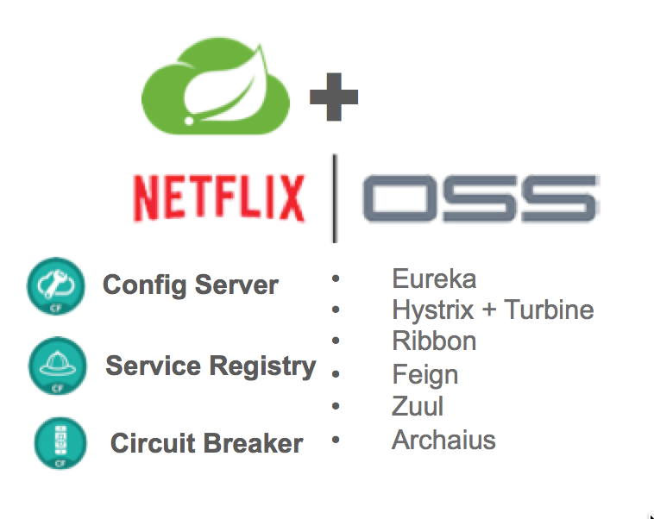

Application Framework
Spring Cloud
Spring Boot
Dev
Spring Boot
From 0 to app in < 5 min
Spring Boot provides
A single point of focus (as opposed to large collection of spring-* projects)
Prebuild “starters”
Common non-functional requirements for a “real” application
Exposes a lot of useful features by default
Gets out of the way quickly if you want to change defaults
Notes:
This month alone, there were over 1.6m downloads, 8m YTD, growing at 10% m/o/m key new projects. Why? because developers love Boot - It’s zero config, super lightweight, runtime ideal for single purpose single process applications aka microservices. With Boot you can go from 0 to app in <5minutes
But remember the concept of fragile infrastructure and designing for failure? How do you wire up all these little processes into a cohesive app that works even when things go wrong?
Luckily Netflix has solved some of these problems at web scale ( their OSS stack is great, but not so easy to use). Swe took that core functionality and built spring cloud. All the power of eureka, hysterix, and config server built as spring modules. As easy adding an annotation and secure for the enteprrise
So awesome even netflix is using it now now we have the app devs able to run super fast and make lots of microservices and tie them together to make amazing apps with spring boot and cloud
But this actually created a huge ops problem …..

Slide 43


D E M O
Notes:
Go to start.spring.io and create an app
Discuss the Gradle/Maven file dependencies

Slide 44

Companies want to be fast like Netflix
Netflix needed to be faster to win / disrupt
Pioneer & vocal proponent of microservices - the key to their speed and success
Netflix OSS supplies parts, but it’s not a solution
Difficult for enterprises to build it themselves
Pivotal offers the closest thing to “Netflix in a box” today
“
“Velocity on the JVM is the Killer App”
- Andy Glover (Netflix Eng) @ SpringOne2GX 2014 Keynote
https://youtu.be/xU267-YHN5c?t=1938
Notes:
NetFlix, an undisputed business & technology leader
34% of peak N. American internet traffic from 6-9pm
If speed was why they won, microservices was how
They pioneered / began to popularize micro service concept
All they had was Amazon EC2 back then
They had to invent a distributed platform, cloud native platform with PaaS – like features
They had to invent microservice infrastructure at the application level
All before writing one line of code that relates to the application you and I know as Netflix
NetflixOSS is a talent acquisition and retention strategy, they are in the movie business 1st, and the software business 2nd.
Open source and supporting their developer’s efforts in the industry is how they are able to attract and retain the best engineers, giving them the ability to invent all this stuff.
That’s tough to duplicate.
Detail on Netflix quote: Netflix needed the performance, stability, concurrency of the JVM, but was searching the right RAD capability to give them the velocity they wanted.

Slide 45


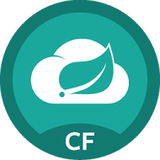
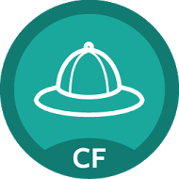
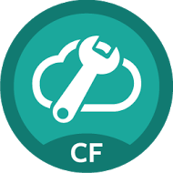
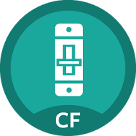
Spring Cloud Services
Rich, production ready library based on Netflix OSS for cloud native components, security and management.
Cloud
Services
Service
Registry
Config
Server
Circuit
Breaker
core
boot
Dev
Ops + Platform
Notes:
So if you’re interested in incubating microservices, how do you get there? These designs there were until recently, exclusively the domain of the Googles, eBbays, and Twitters, have now gone mainstream. How can you build a microservices application today at your organization? Well, you’ll want to build it using your existing developers' skills.
If you’re a Java shop, there are some great OSS tools available. Spring is #1 Enterprise Java App Dev Framework. Everything is open source.
The Spring Cloud adds distributed system components for configuration management, service discovery, circuit breakers and more.
It’s platform aware and provides an integrated spectrum of opinions. Convention over configuration .
We’ve packaged these components up so your developers can run them on the platform as attachable backing services. It’s built into our Spring Cloud tile.
Finally, Spring Boot adds Rails-like packaging and lightweight app server so your devs

Slide 46
D E M O
Notes:
Go to start.spring.io and create an app
Discuss the Gradle/Maven file dependencies
Show Fortune Teller

Slide 47


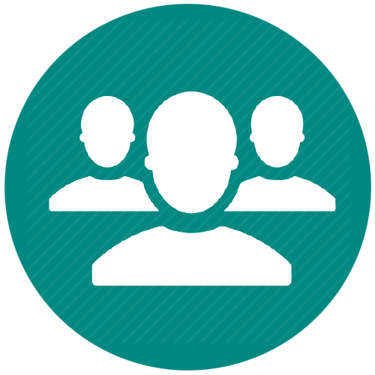


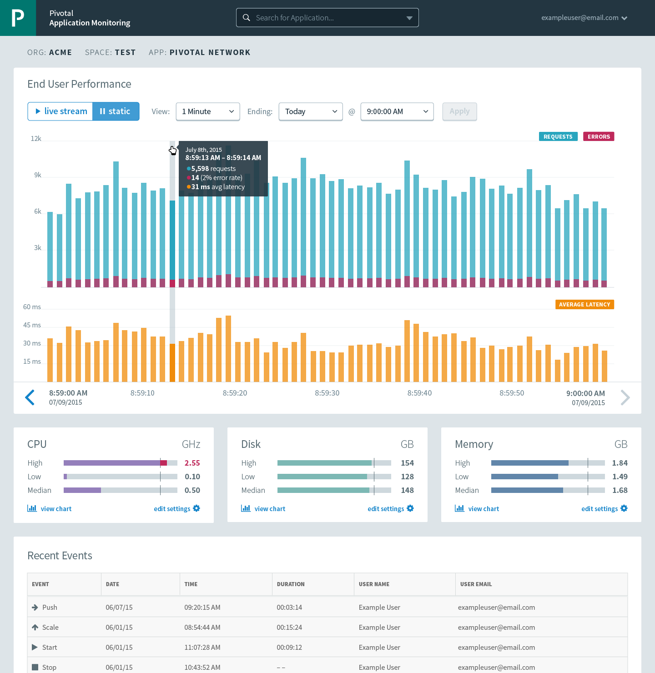


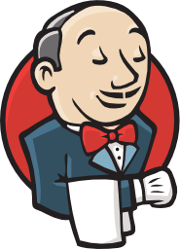

Runtime Platform
Dev
IT Ops
Cloud Foundry
Mobile Services
Centralized Log Management
Networking & Load Balancing
Auto-Scaling
APM & Tracing
APPLICATION
Health management
Full Stack CI/CD platform
Notes:
So Spring Boot/Cloud meant create apps fast – But Dev & Ops is asking Day2 questions -
How do you do logging, routing, apm, scaling, and lifecycle management of all these apps.
Enter CF Runtime
best in class container management
integrated agentless logging
with APM
auto scaling
Effortless runtime with minimum human operational overhead. We run 1000s of apps and 10,000s containers on PWS with 6 guys.
But we realized that stopping there wasn't enough

Slide 48

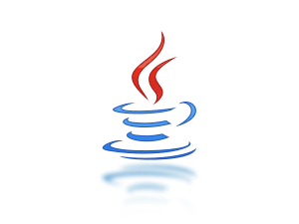


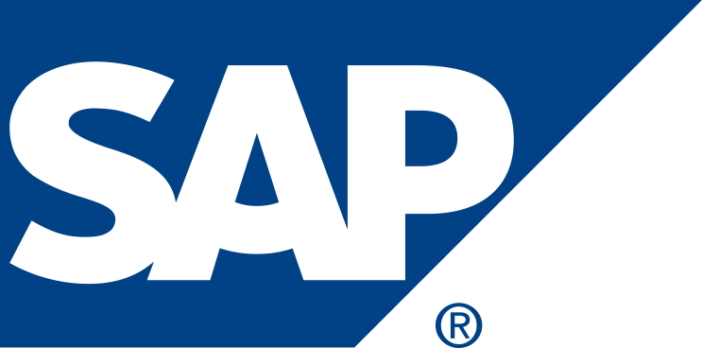
APPLICATION
Infrastructure as code
Security & Isolation
Language Agnostic
Integrated Data Services
Growing ISV & Partner Ecosystem
Cloud Agnostic
Day 2 Operations
Infrastructure Automation
IT Ops
BOSH
Infrastructure
Azure
IT Ops
Notes:
We needed to orchestrate the infrastructure to support this runtime. CF tells the infrastructure what to do and has a common API to support various infra types – AWS, vSphere, Openstack, Azure
When things break (and they will), the notion of self healing kicks in. There is no calling IT Ops, opening tickets, adding new VM’s, creating VM templates, upgrading Operations system, all that is automated and CF takes care of that.
And that gives you - Zero downtime, No maintenance windows
No managing OS upgrades, No managing VM’s
An amazing Operations savings story. What can you do with that time and labor savings ?

Slide 49
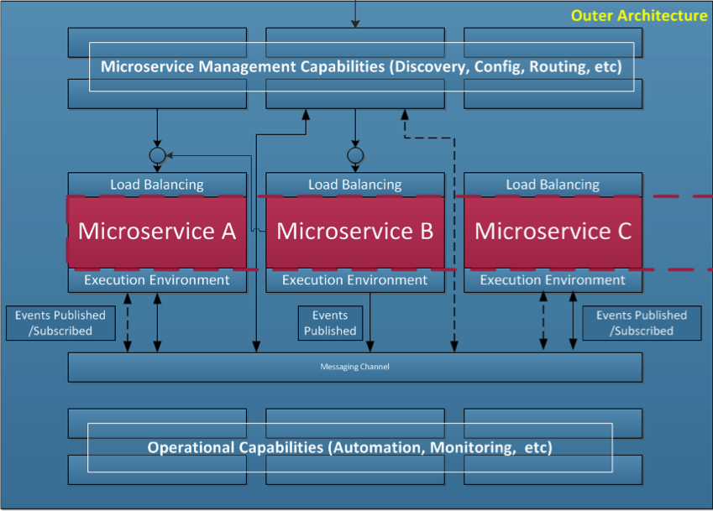
Cloud Native Platforms Provide the Outer Architecture
“The hardest part of building microservices is in the outer architecture (All of the blue boxed components).”
Inner
Architecture
“Easiest part of the microservices is in the inner architecture. The architecture of an individual microservice.”
Notes:
This slide is from T-Mobile – it is from a POC under Steve Hull’s group evaluating microservice architectures on public cloud infrastructure.

Slide 50
Ops Loop
8. Upgrade
Dev Loop
1. Provision
6. Run
1. Design
7. Recover
2. Authorize
Biz
6. Scale
5. Deploy
2. Build
3. Integrate
3. Configure
5. Audit
4. Monitor
Notes:
Why are you enabling continuous development?
The goal is to speed up your team’s clock cycle.
If your developers are self service, if they’re spending less time on operations, then you can increase your clock speed.

Slide 51

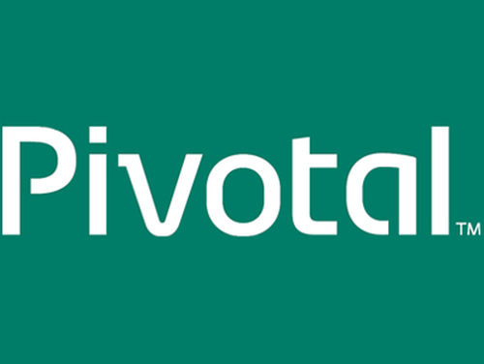

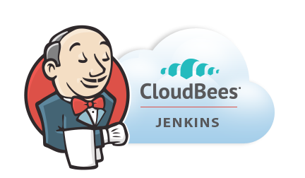

Application Lifecycle Management: CI/CD
Agile Project Management
AUTOMATION.
Integrate tools and automate processes from testing to builds and deployment.
SPEED.
Releasing more frequently with fewer bits will reduce complexity and improve time-to-market.
QUALITY.
Shorten feedback loop using test-driven development to surface problems sooner.
AGILITY.
Push updates on regular basis with no downtime to improve customer experience and time to market.
Commit Code Change
Automate Build & Test
Manage Binaries & Build Artifacts
Pivotal Cloud Foundry (Elastic Runtime)
Build Pipeline Operations
Tool Chain
Gitlab
Jenkins
Develop, Test, QA and Production on the same platform.
Horizontal scaling, high availability, security, logging, update management
Built-in ecosystem of services.
Deploy, operate and scale on IAAS of choice.
Simple, developer friendly commands and APIs.
Distributed revision control and source code management. Collaborative software development.
Build, test and deploy software projects continuously and incrementally. Thousands of compatible plugins.
Share binaries and manage distributions. Manage artifact lifecycle.
Notes:
Commit
Build/test
Manage artifacts

Slide 52
Cloud Native Maturity Model
Cloud Native
Microservices architecture
API-first design
Fault-tolerant and resilient design
Cloud-agnostic runtime implementation
Bundled metrics and monitoring
Proactive failure testing
Cloud Resilient
Cloud Friendly
12 Factor App methodology
Horizontally scalable
Leverages platform for high availability
Cloud Ready
No permanent disk access
Self-contained application
Platform-managed ports and networking
Consumes platform-managed backing services
Notes:
Cloud Ready: No mounting file systems!
Cloud Friendly: Scalable, platform provides HA
Cloud Resilient: Cloud Agnostic, Fault Tolerant
Cloud Native: microservices + API first

Slide 53
HOW
Do we get started
Notes:
Now I’d love to open this up for discussion.

Slide 54
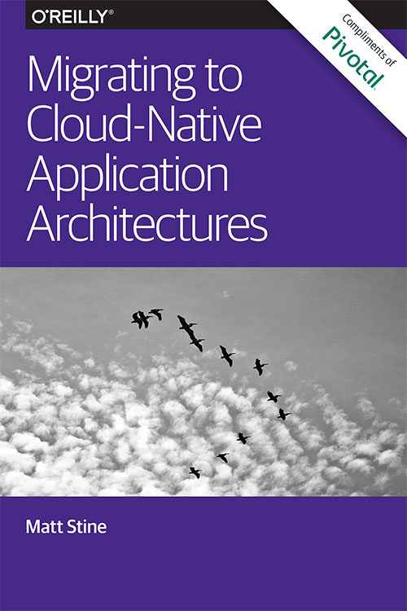
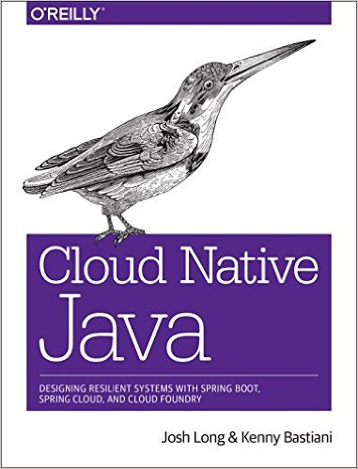
Read
By Matt Stine (@mstine)
By Josh Long (@starbuxman)
and Kenny Bastani

Slide 55
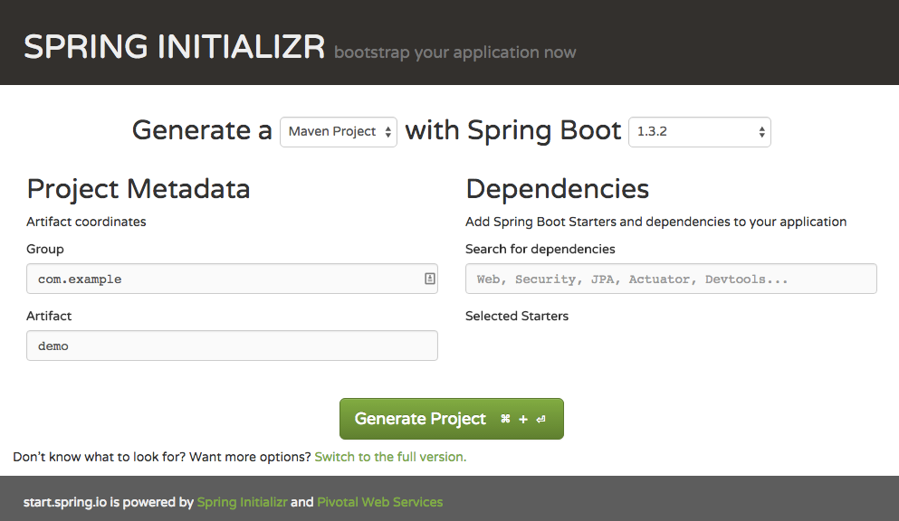
Bootstrap your Application Now: http://start.spring.io

Slide 56
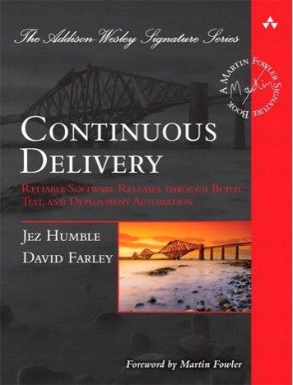
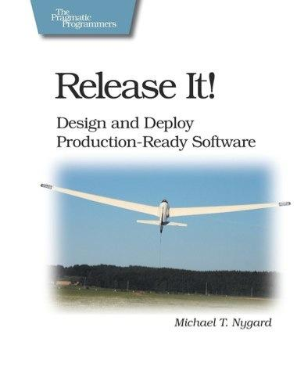
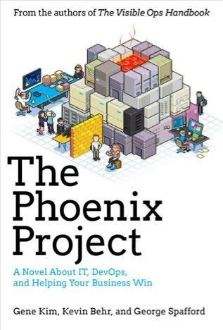
Foundations
Notes:
continuous integration of development changes
one package / many deploys
automation
deploy smaller batches more frequently
automate all testing where test failures would prevent prod release

Slide 57
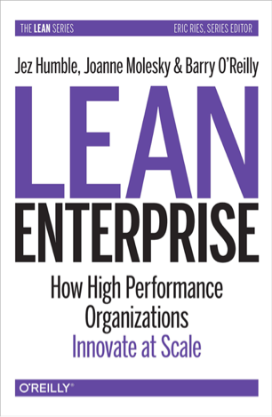
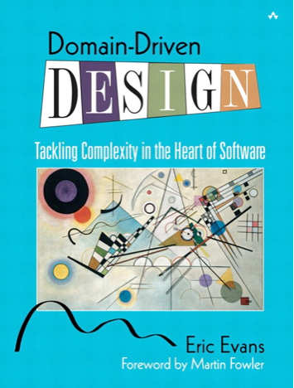
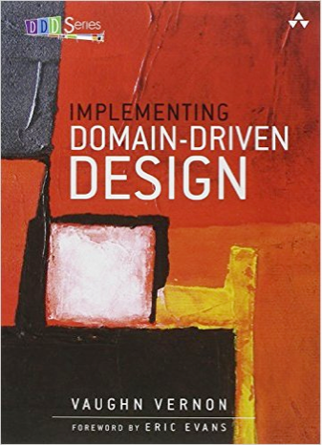
Foundations
Notes:
continuous integration of development changes
one package / many deploys
automation
deploy smaller batches more frequently
automate all testing where test failures would prevent prod release

